Slide 1


Managing population health needs in primary care : an experience in the
13th borough of Paris
Hector Falcoff
European Forum for Primary Care, Nanterre, 1st October 2019

Slide 2
I have no conflict of interest that could influence the content of the presentation

Slide 3
Some steps in the organization of ambulatory care in France
2000, « the networks era » : palliative care, addiction, gerontology…(« expertise in silos »)
2004 : the patient list (médecin traitant)
2011 : GPs payment for public health goals
2016 : a flat rate for the PC organizations
Since 2003 : more and more group practices :
  Primary care teams (Equipes de soins primaires)
  Maisons de santé pluriprofessionnelles
  (Multiprofessional Health Homes)
  Health Centers (Centres de santé)
2016 : Local Professional Health Communities
(Communautés Professionnelles Territoriales de Santé – CPTS)

Slide 4
Local Professional Health Communities
Communautés Professionnelles Territoriales de Santé
CPTS (defined by law in 2016) = The place for organizing and coordinating ambulatory health professionals around a population in an area.
Areas with 20 000 to 100 000 inhabitants.
The initiative to create a CPTS is left to the health professionals of the area, at least initially.
Each CPTS must have a health project, based on a health needs analysis.
CPTS are funded by the National Health Insurance since 2019 (up to 400 000 € / year)

Slide 5
Six essential missions
To organize preventive actions
To guarantee access to a personal GP
To organize the answer to not scheduled demands of care (on the same day if necessary)
To organize timely access to specialists consultations
To ensure safe transitional care
To organize home care for frail patients, elderly patients , and multimorbid patients.

Slide 6
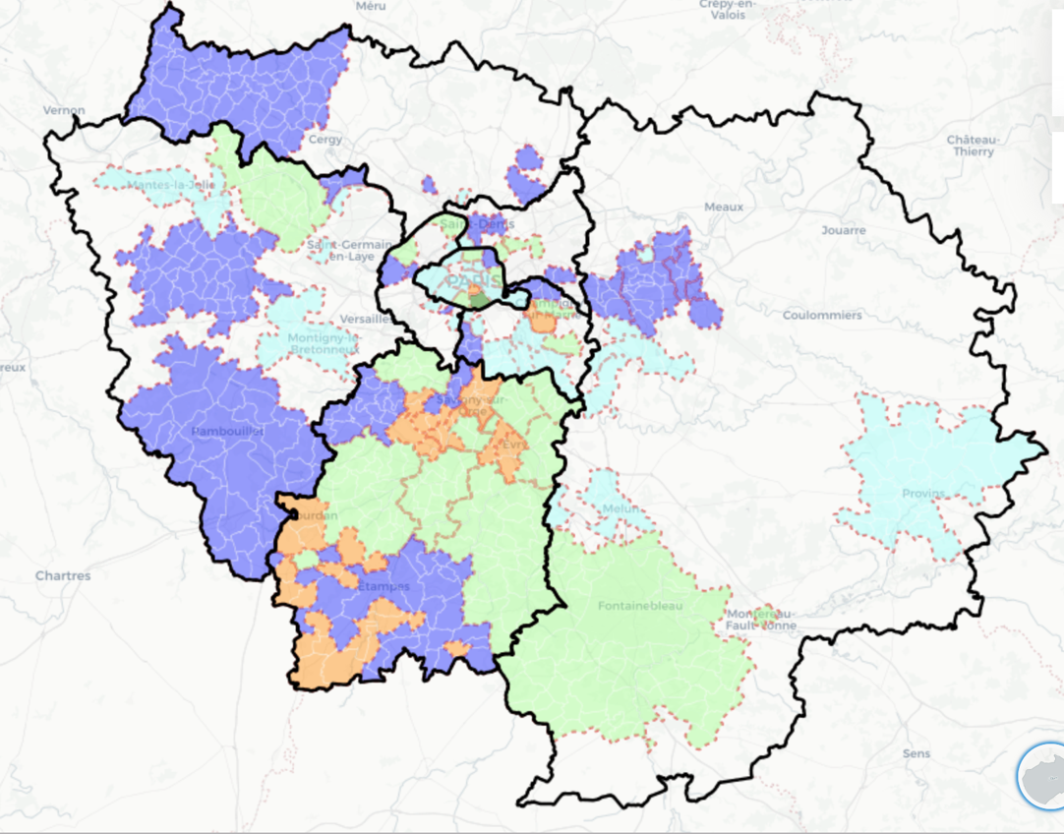
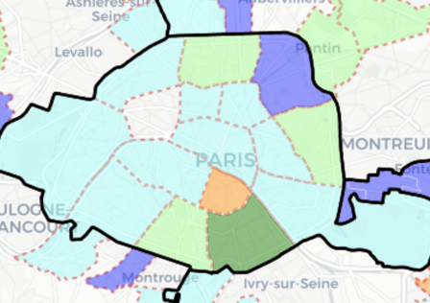
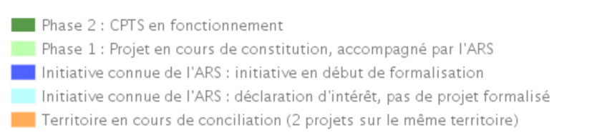
22
9
29
15

Slide 7
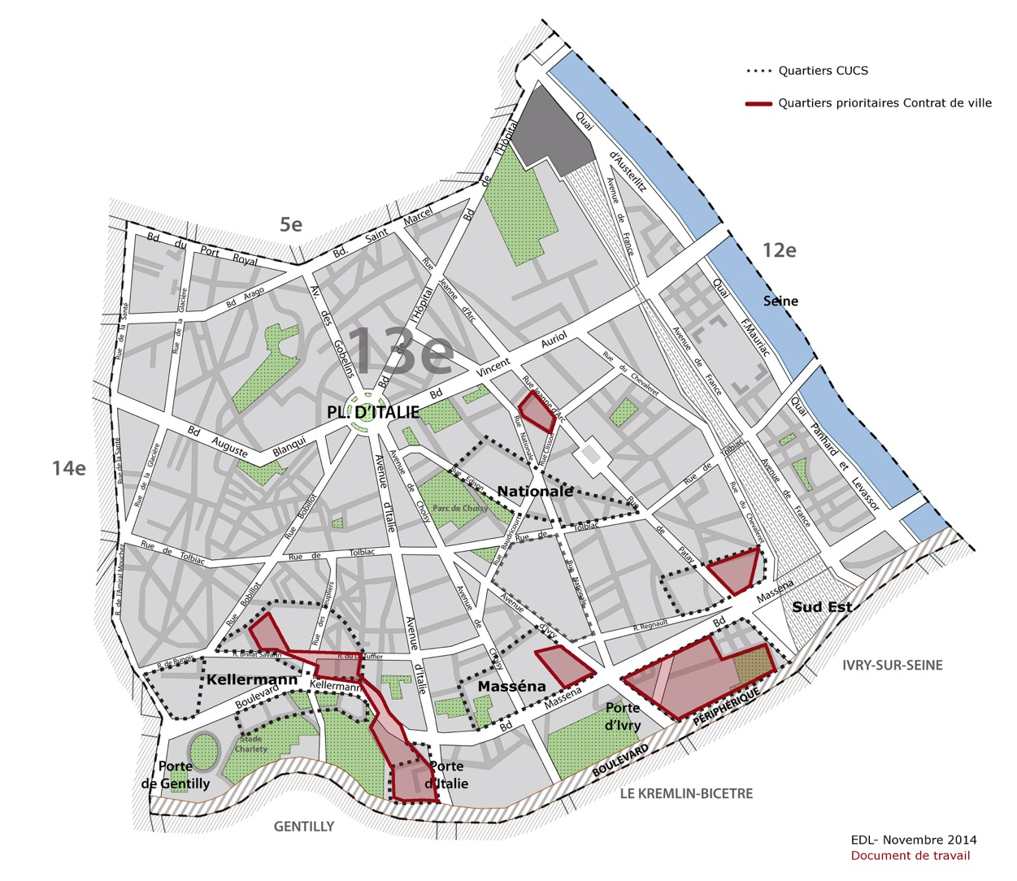
13e arrondissement
(13th borough)
185 000 inhabitants

Slide 8
CPTS Paris 13 : the constitution
Health care organizations
Health & Social Professionals
Citizens, users, patients organizations

Slide 9
Values
Shared responsibility
To serve the patients, the population, the professionals
Multiprofessionality
Remove the barriers between the health and the social sectors, between primary care, the specialists, the hospital
Quality (patient centredness, equity, safety, efficiency)
Act local, think global

Slide 10
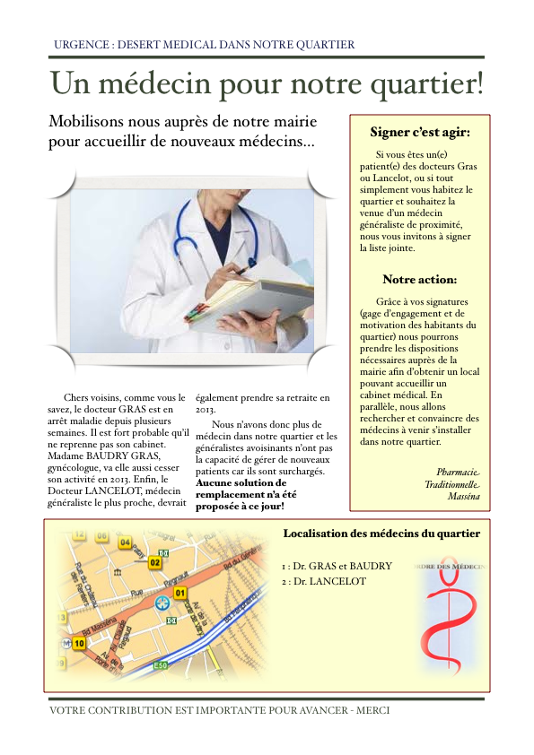
2012 : a petition
In the south-east part
of the borough

Slide 11

Maisons de santé
pluriprofessionelles
du 13e
Lahire (2018)
Chevaleret (2019)
Maryse
Bastié
(2018)
Porte d’Italie(2020)
Yersin
2016

Slide 13

Moi(s) sans tabac
Training of pharmacists to the evaluation of nicotin addiction.
Free distribution of nicotin replacement therapy to dependent smokers in the pharmacies in november
Evaluation at 3 months : 16% to 24% of included subjects declared abstinence from tobacco

Slide 14


Slide 15
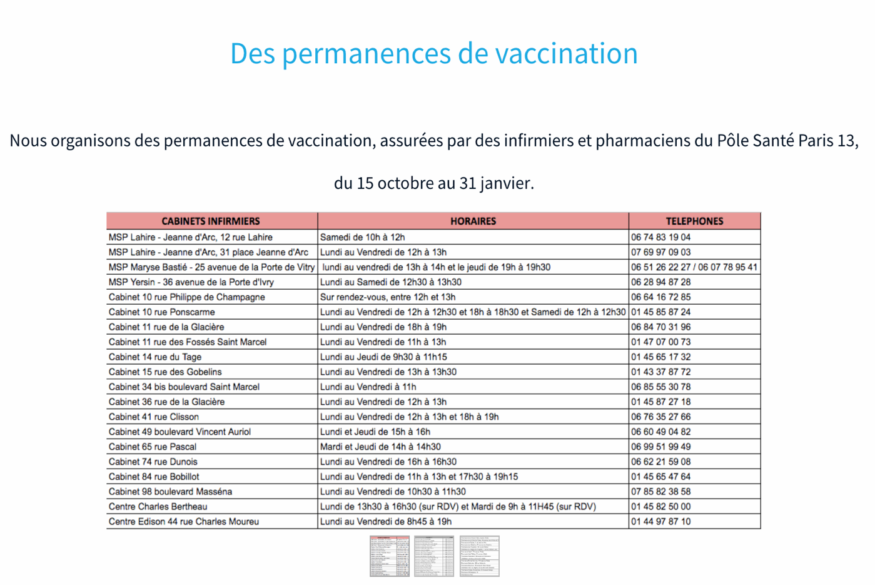
20 nurse practices
41 pharmacies

Slide 16
How to identify the population’s health needs ?
Epidemiological data
(unfrequent at the local level)
Guidelines
Local surveys
(medical students dissertations…)
Informal discussions (with other professionals, patients, other actors in the area)
Structured discussions (focus groups)

Slide 17
What to do next ? (1)
Identify all the actors concerned/interested by the topic in the area
Offer to organize a working group
Ask the group to imagin what the action could be
Find a leader for the project (a motivated person in the group)
Ask the leader to write one page about the project and to improve it within the group

Slide 18
What to do next ? (2)
Bring support to the leader
Make a pilot (invest some money)
Collect data
Find funding
Implement the project on a larger scale
Lack of time from professionals is the main barrier, keep it simple
And…

Slide 19


